Slide 1
Asynchronicity in Node
Concurrency is how Node.JS handles some of the world’s heaviest, scalable workloads on it’s seemingly ‘single-threaded’ event-loop.
Concurrency in very simple terms means that two or more processes (or threads) run together, but not at the same time. Only one process executes at once.
https://medium.com/platformer-blog/node-js-concurrency-with-async-await-and-promises-b4c4ae8f4510

Slide 2
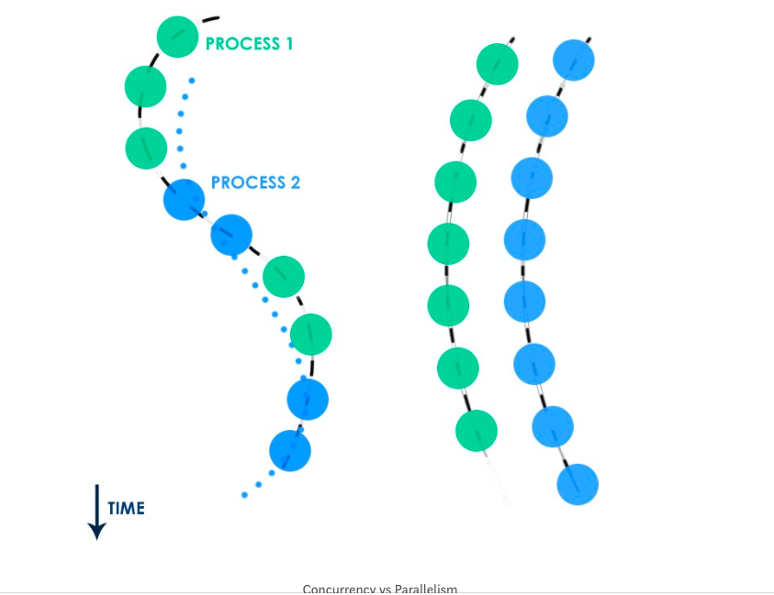
Asynchronicity

Slide 3
Promises
Writing code with callbacks might become wordy and not maintainable in the long run.
We have promises to our rescue.
A promise will return a whether we are successful in doing the function or failed of an asynchronous block of code.
Make our code much cleaner

Slide 4
Promises
Syntax:
const myPromise = new Promise((resolve, reject) => {
// do something asynchronous which eventually calls either:
//
// resolve(someValue); // when fulfilled
// or
// reject("failure reason");
// upon failure or rejection
});

Slide 5
Promises
resolve():
Whatever is passed into resolve() callback will be available to the .then()function of that Promise object.
Reject():
Anything that’s passed to the reject()callback of a new Promise can be caught in .catch()

Slide 6
Package
A package is just a directory with one or more files in it, one of which is called package.json, which contains some metadata about the package.
npm itself consists of:
A package registry, which is a big database with info about all publicly-shared packages.
A command-line tool that allows developers to work with and share packages

Slide 7
NPM
In node ecosystem, we have a lot of third-party libraries to help expedite our development.
NPM is your gateway to these libraries
NPM, included with the node distribution, can install more libraries
Essentially a package manager

Slide 8
Installing packages locally
One of the main uses of npm is to install publicly-shared packages to use in your own code. For example,
npm install async
To install a library and track it as a dependency (in package.json)...
npm install LIBRARYNAME --save
To install without tracking as a dependency...
npm install LIBRARYNAME
To install and track as a dependency only for development (useful for modules that are, themselves,
tools)...
npm install MODULE --save-dev

Slide 9
Async, await
Async, Await – a third-party library
Install them in your directory using npm install <library name>
You will have two keywords, ‘async’ ‘await’
await can ‘wait’ for a async function to resolve or reject a value and allows us to handle the return value without using .then() or .catch()
async is a special keyword attached to function declarations to let the Node interpreter know that it’s an asynchronous function.

